Slide 1






API Design & Implementation
Api DEMO Using Postman
Client Management
Screenshots of the api endpoint calls using Postman
Real-time date and time for authenticity
Concurrent api logs
Register and list clients.
Program Management
Add and list programs.
Enrollment Management
Enroll clients and track participation.
By: Chris Kinungi
Documented with OpenAPI for easy access.
Notes:
1

Slide 2
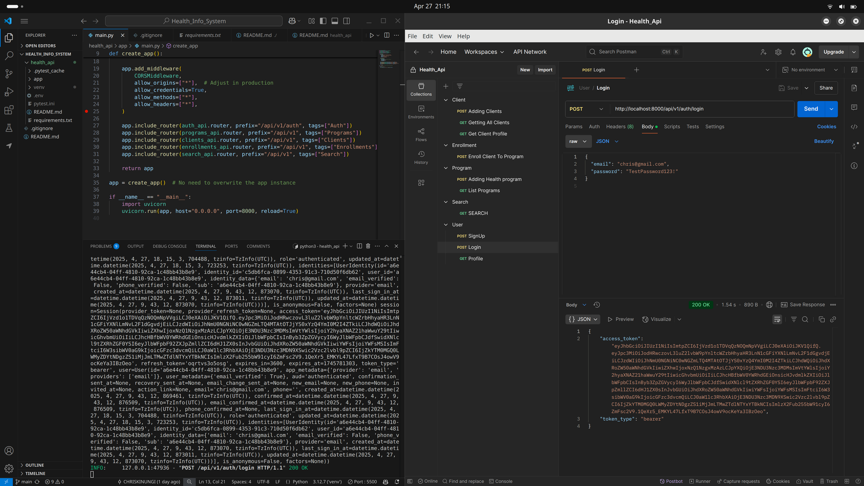

Slide 3
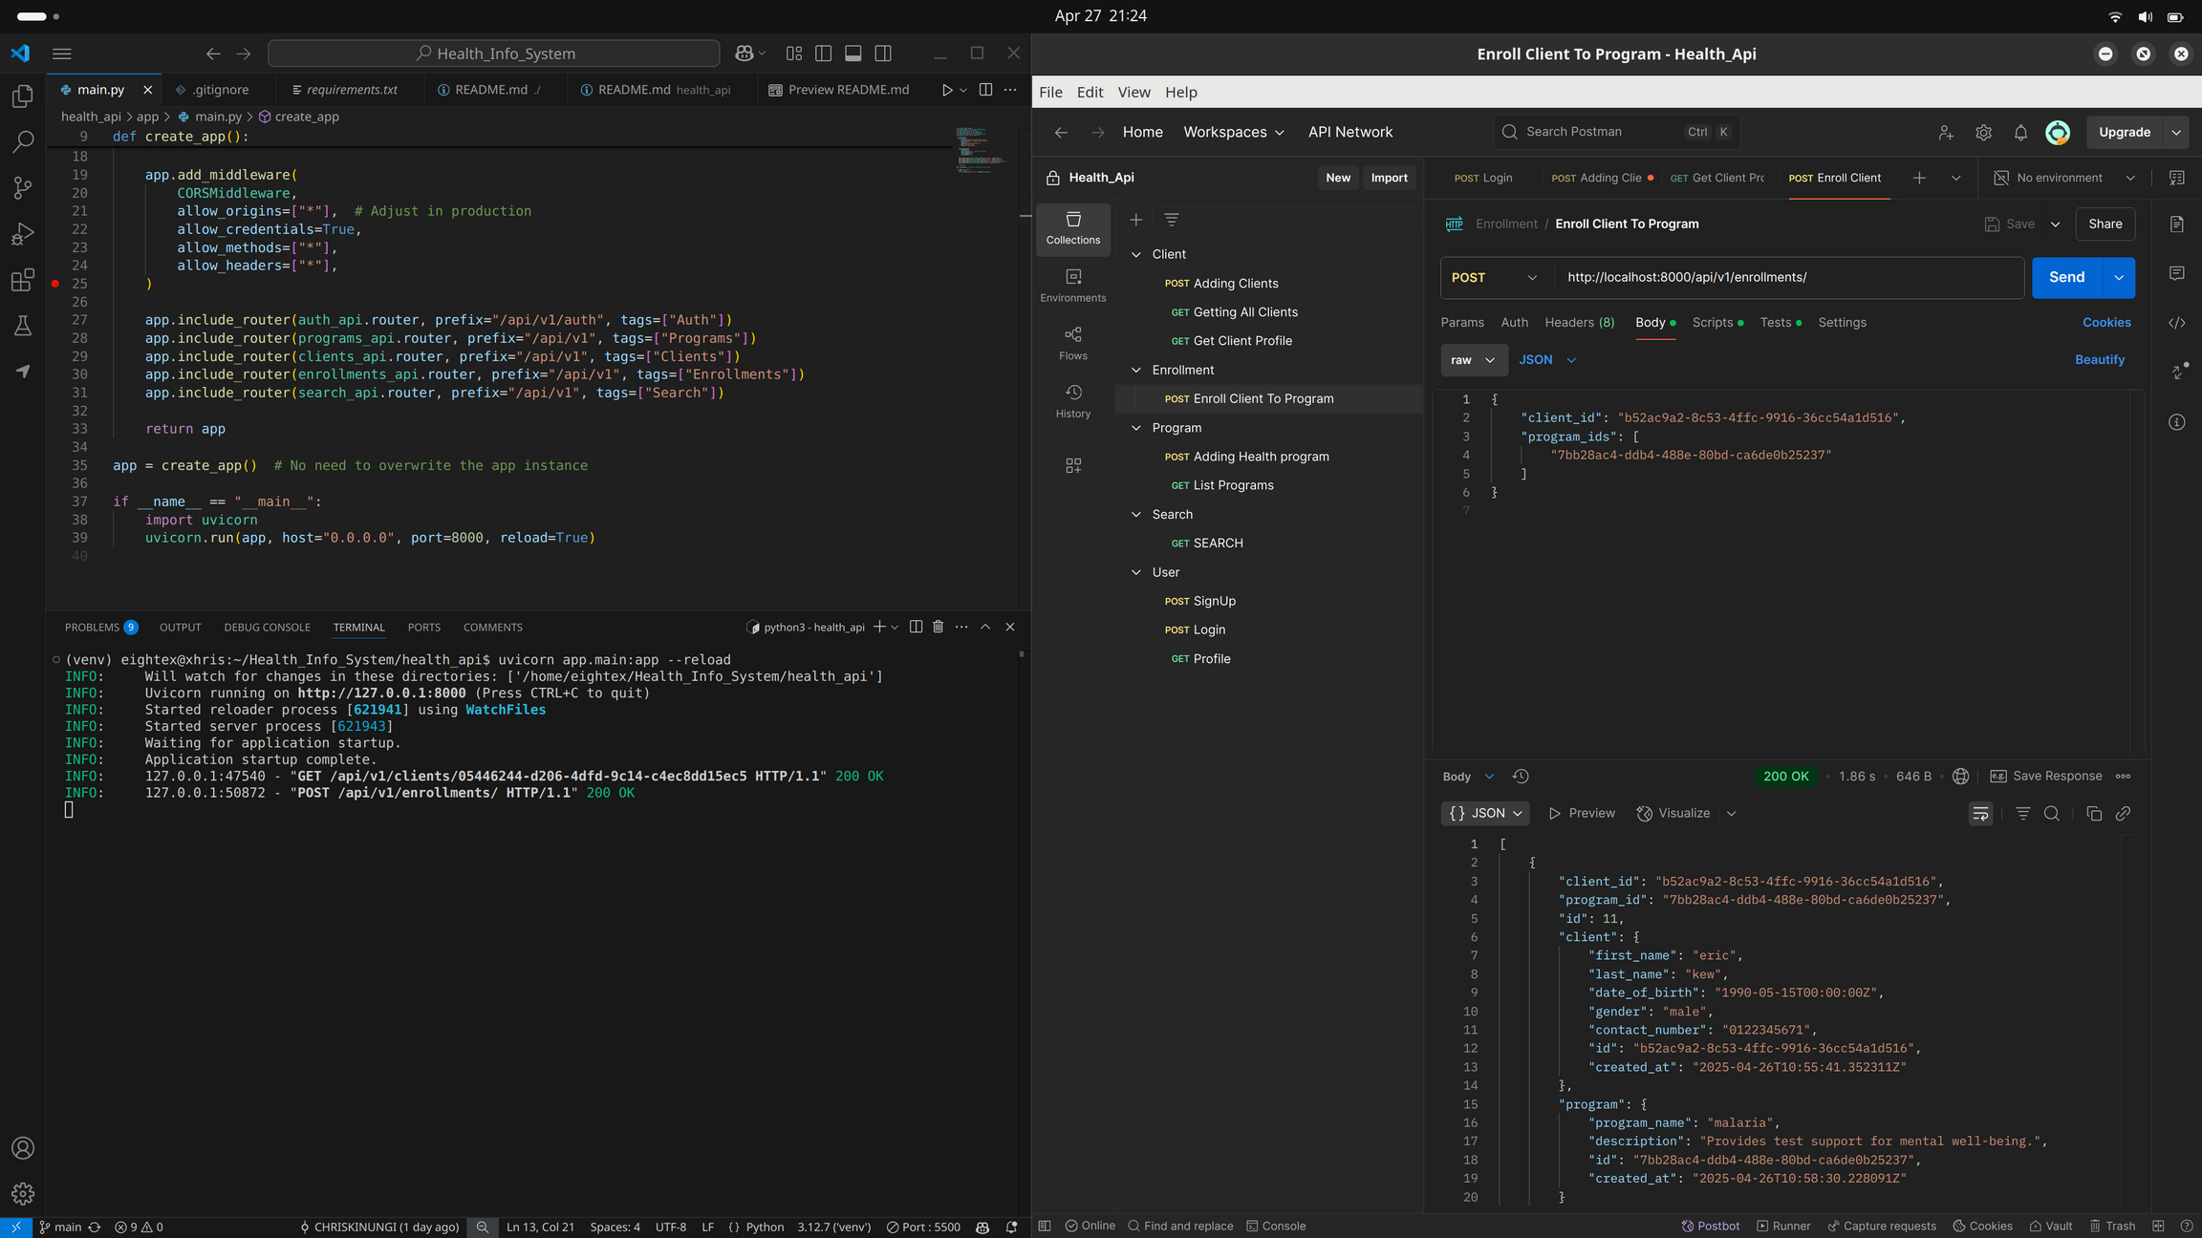

Slide 4
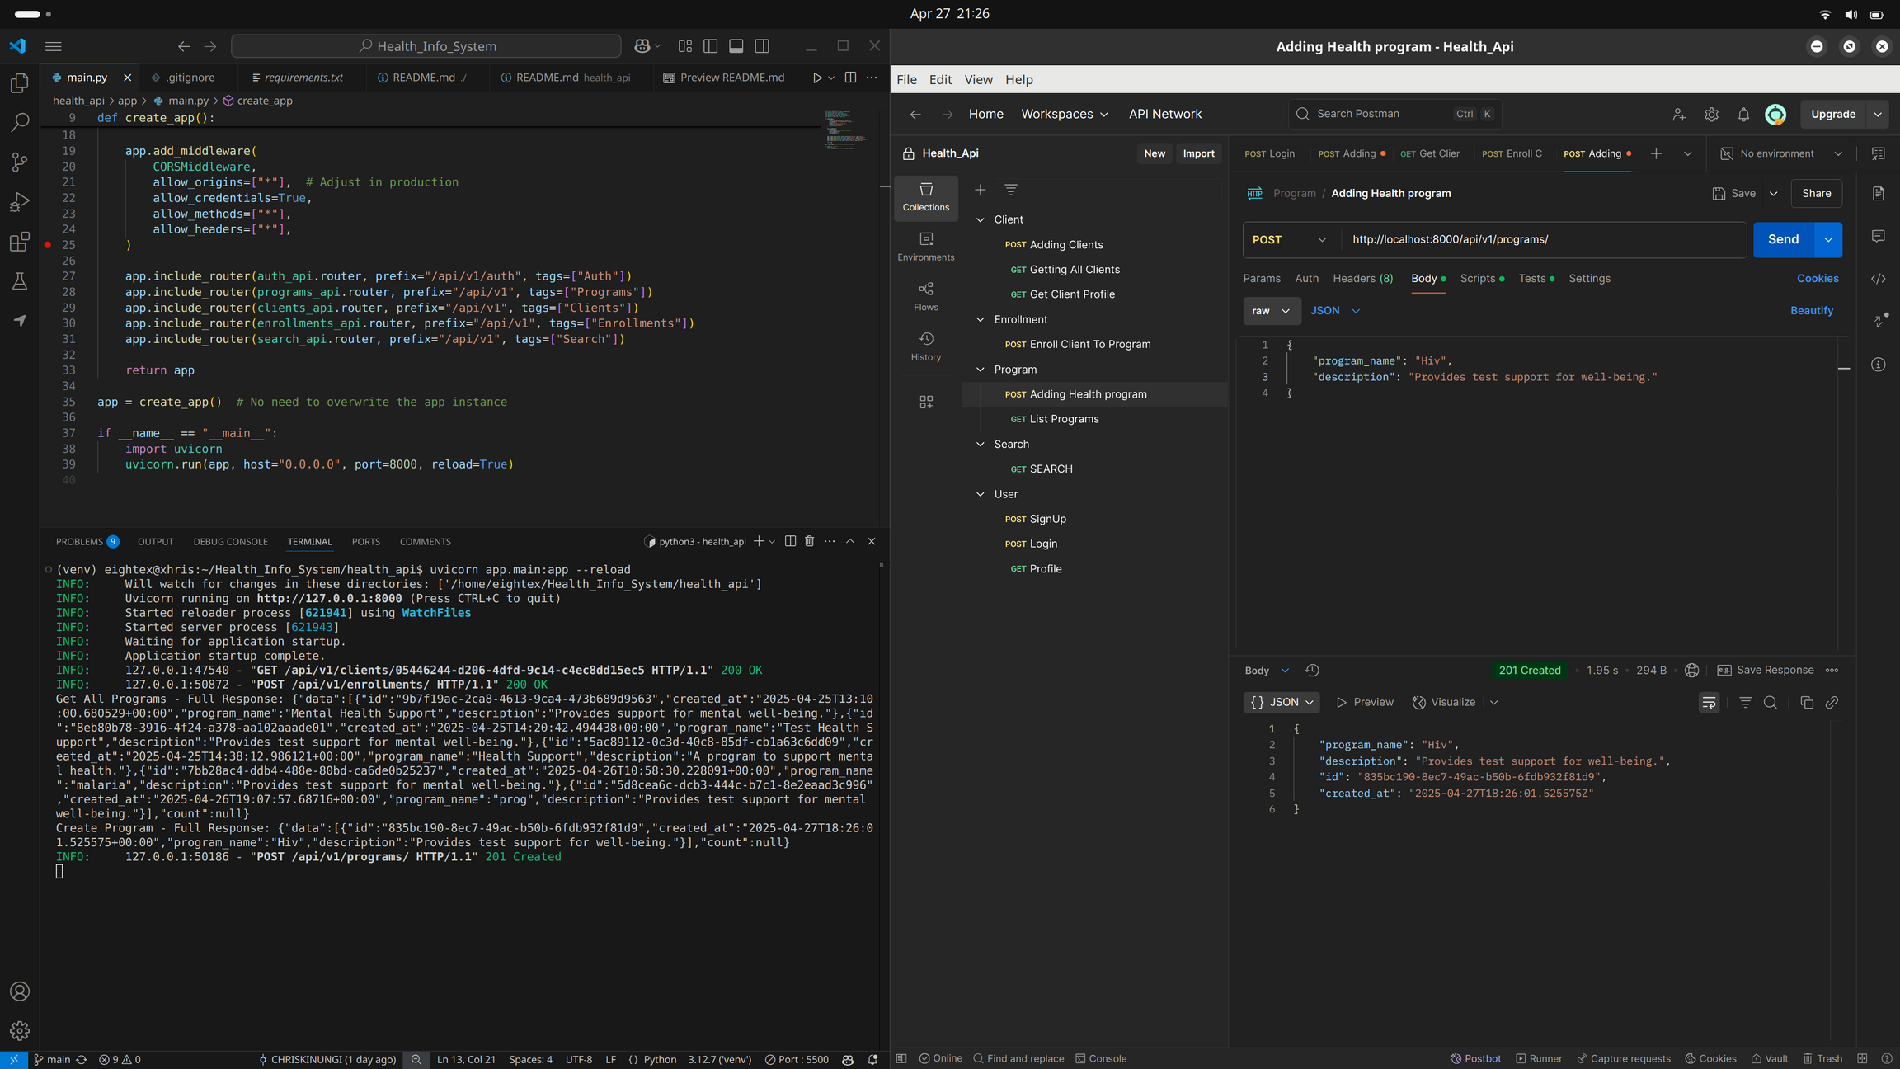

Slide 5
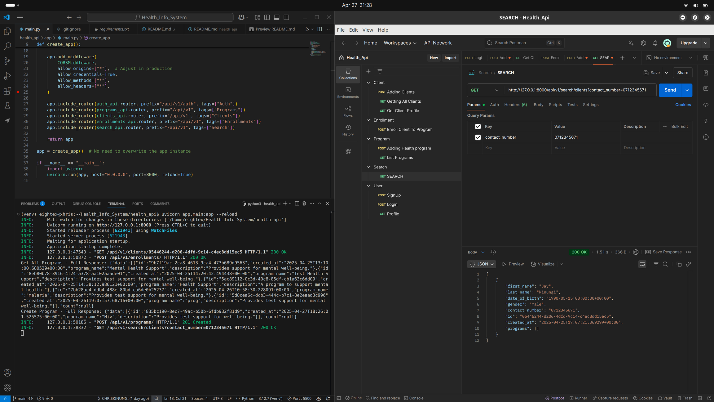

Slide 6
